Slide 1


Greengineering
An idea that will change the world
Warning Planet, cool ideas
SpaceApp, Madrid 2019

Slide 2

Warming planet, cool ideas
Get a modern PowerPoint Presentation that is beautifully designed.

Slide 3
Our Dream
One Movement
One Action
One Idea

Slide 4
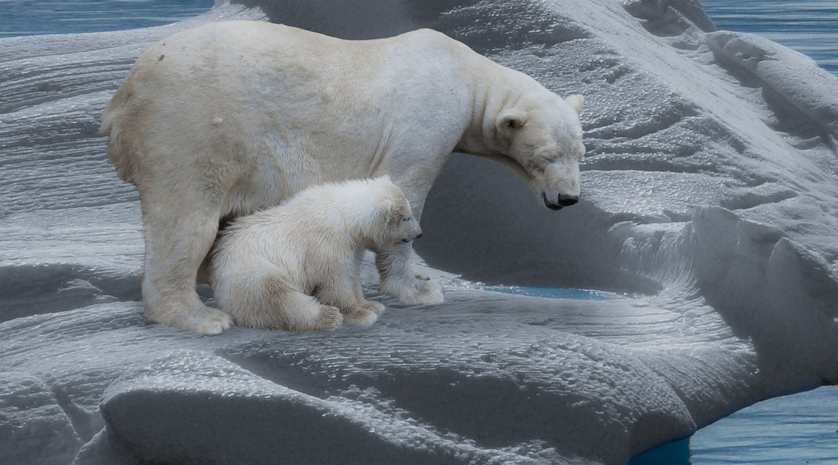
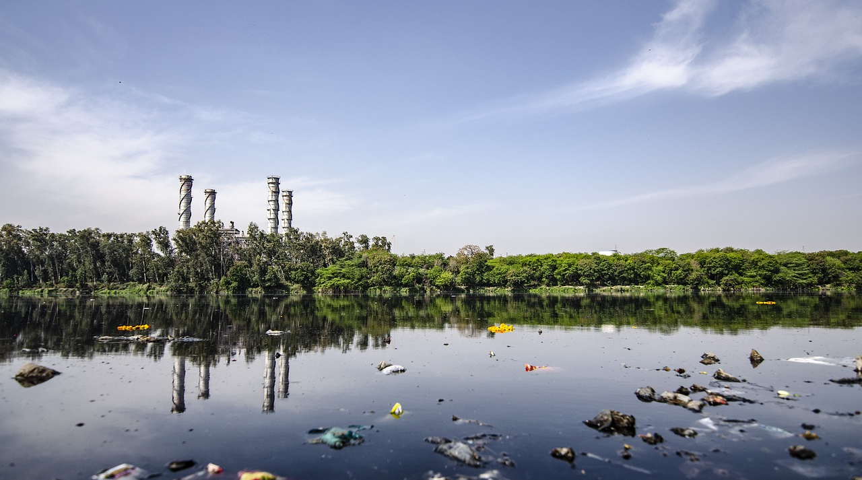

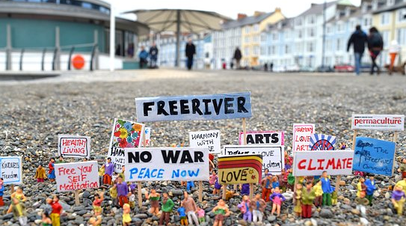
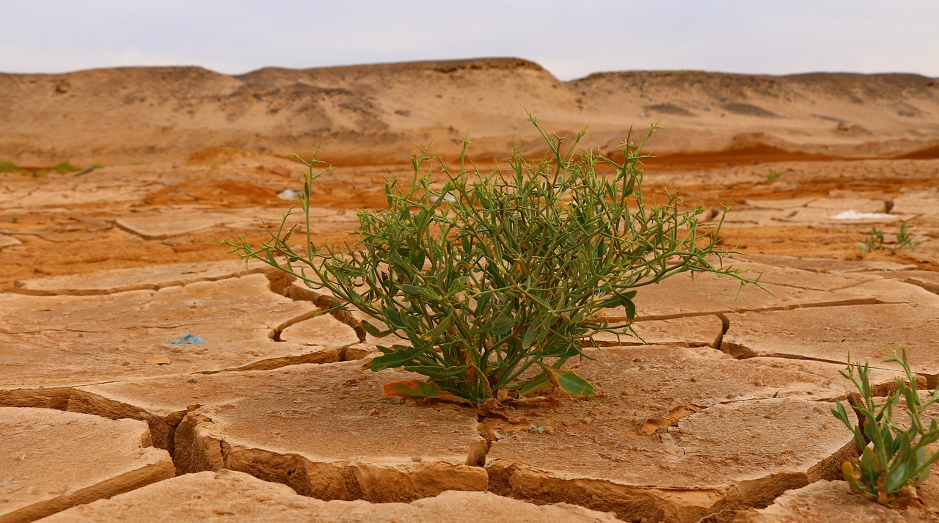
WHY

Slide 5


Interactive APP
Identify Actions Repercussion

Slide 6
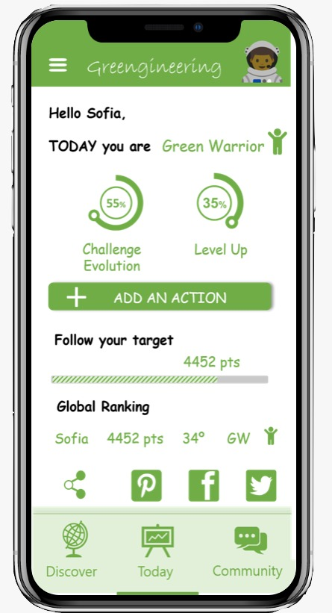
Greengineering
01
Your status
Global Ranking
04
02
Your evolution
Share and connect
05
03
Your target

Slide 7
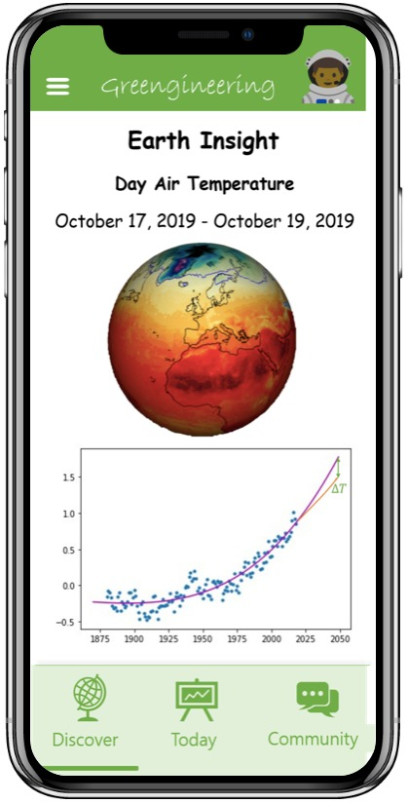
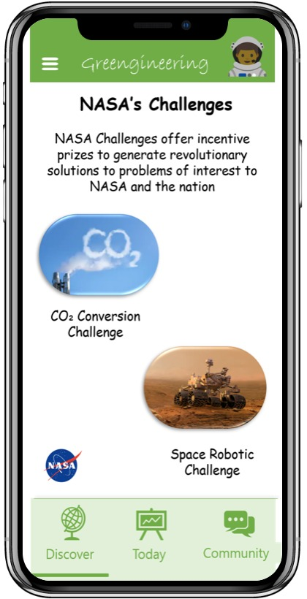
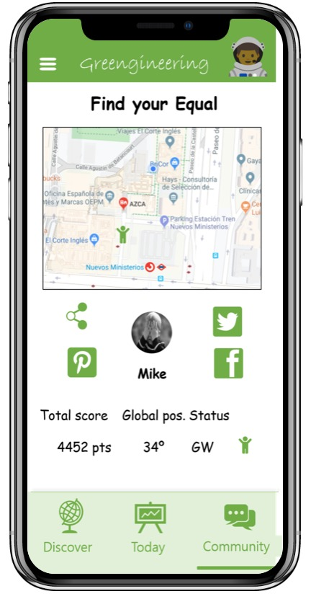
Greengineering

Slide 8
Backstage
Based on NASA real data

Slide 9
Data Analytics
Temperature Incrementation Identification
Finally we compare the expected projection of temperature versus impacted Temperature projection
Temperature Impact
The emission of a
Then we escalate this CO2 emission to a relevant amount of actions and project it towards a relevant time
CO2 PPM
Escalate the CO2
CO2 Parts Per Million in the Atmosphere
It is necessary to translate this CO2 emissions into
One Action CO2
The emission of a single action
First we identify the CO2 emission saved by a positive action

Slide 10
Lets start Today
Find an equal
Download the APP
Complete a challenge

Slide 11
Thank you
Questions time

